Slide 1
3D Mapping of Industrial Environments for AR
2
  Category: Technology Maturity Assessment
Most Relevant Research Agenda Topics:
https://thearea.org/using-3d-and-world-mapping-standards-to-streamline-ar-experience-production/
https://thearea.org/area-research-agenda/opportunities-for-ar-cloud-technologies-in-enterprise/
https://thearea.org/area-research-agenda/informing-ar-users-about-hazards-in-proximity/

Slide 2
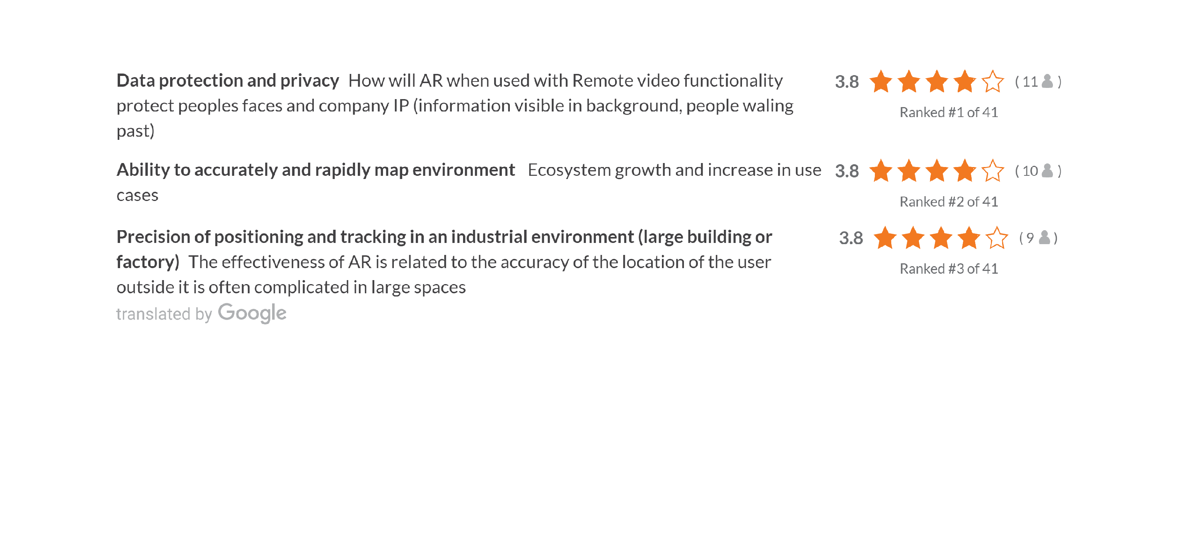
Top Three Think Tank Topics

Slide 3
Current Situation
Enterprise AR experiences rarely leverage 3D maps of the environment. As a result, AR content cannot be placed in the spatial context of the user’s work environment and hazards are not part of the full experiences provided to users
Lack of spatial context means that other AR content not originally compiled in an experience, cannot be associated with the environment (e.g. procedures, IOT data, service notes, etc.)
Practical knowledge about the tools and techniques for creating 3D reality maps rapidly (offline or in-situ) for use by multiple AR platforms and other tools/use cases is low

Slide 4
Problems this Research Would Address
AR providers and customers are not sufficiently adept when producing/using 3D mapping as part of their deployments
They lack the detailed knowledge of technologies to
  Choose when/how/with which partners to add 3D mapping to their tool chains
  Prepare environments for fast and accurate 3D capture/mapping
  Integrate reality capture into authoring platforms and feature detection from 3D maps into AR experiences
There could be much more innovation in commercial reality capture systems (separate from the AR authoring)

Slide 5
Possible Questions the Research Would Answer
What potential efficiencies can an enterprise gain by including 3D mapping into their overall solution?
What vendors provided solutions that leverage 3D mapping are available and what features do they provide?
What are the most common outputs of real world capture systems used in enterprises and suitable or designed specifically for AR use?
Where are standards in 2D and 3D (spatial) mapping applicable to the use of real world capture system outputs?
What are the existing standard interfaces of a domain-specific engineering pipeline in an industry that is currently seeking to adopt AR?
What are the gaps in existing standards and where can future standards focus for highest impacts on reducing costs of AR experience authoring?

Slide 6
Whose problems would be addressed?
IT groups and enterprise AR project managers would be better prepared
  To use real world capture systems as the basis for AR experience authoring
  To reduce reliance on customized authoring processes and accelerate/streamline the production of AR experiences
Providers of enterprise wearable AR displays and enterprise AR software/platform companies would be able
  To participate in the development of extensions of existing standards, or new standards, and/or
  To adopt standards identified in this study to lower the risk and costs facing customers seeking to use 3D mapping when introducing AR at scale

Slide 7
How would this research be conducted?
Perform desk research about commercial 3D real world capture systems currently in use in enterprise environments and document any data formats and standards used
Perform research about available software to leverage 3D spatial data in the enterprise across multiple domains (e.g. manufacturing)
Compare interfaces, models and standards used by the industry (domain) with the inputs and outputs of the real world capture systems
Prepare a gap analysis and set of recommendations for future work in enterprises and standards organizations

Slide 8
Deliverables of this Project
An annotated table of specifications pertaining to products and technologies in use in 3D mapping systems in use in enterprise today
An annotated table of standards and/or software in use in multiple domains where enterprises can gain efficiencies from leveraging 3D mapping of the environment in which AR experiences are delivered
Report containing a gap analysis and set of recommendations for future work in enterprises and standards organizations
Executive summary of findings for public release and a webinar

Slide 9
Benefits to AREA Members
Deeper insights into how 3D environment mapping can translate into increased efficiency for customers
Deeper insights into the standards/techniques used to capture, store and use 3D maps of the workplace
Insights into the available software for leveraging 3D maps in authoring/management/deployment of AR technology
If/when AR experience authoring can leverage the 3D maps of the workplace, this will reduce costs, time and errors that are inherent when humans are required to custom engineer AR experiences

